Slide 1

COPD PREDICTION USING ML & CHATBOT ASSISTENCE
GUIDED BY
Mrs. Jasmine Rajula , ME
Assistent professor
PRESENTED BY
JEBA MISRA R (960221243025)

Slide 2
ABSTRACT
COPD is a serious lung disease that makes breathing difficult
It is caused by continuous exposure to harmful gases such as tobacco smoke and air pollutants .
Early detection is important to prevent complications .
The system allows users to upload a lung sound file, and predict the risk of COPD .
The system includes a chatbot that helps users understand their condition by answering questions about COPD, symptoms, and prevention methods.
Users can also schedule appointments with nearby doctors.
The system comprises two main modules:Admin Module: Admins can manage user data, view registered users, and handle doctor information and user feedback.User Module: Users can register, log in, upload breathing sounds for prediction, search for doctors via a location filter, interact with the chatbot, and provide feedback.

Slide 3
INTRODUCTION
COPD affects millions of people worldwide and is expected to become 3rd position of death by 2030.
To solve this problem, The System uses (ML) to analyze lung sound recordings and predict COPD risk.
The system is built using deep learning models such as CNN and LSTM to process breathing sounds and detect patterns The platform is developed using Python (Django framework) with SQLite3 for data storage and built with HTML, CSS, and Bootstrap.
A chatbot is integrated into the platform, giving valuable information to users about COPD, its symptoms, risk factors, and preventive measures. By providing interactive support, the chatbot enhances user understanding .
This system consists of two primary modules—Admin and User . Admins can see user data, manage registered doctors, and monitor feedback . Users can register, log in, upload sound recordings for disease prediction, search for doctors, and interact with the chatbot for guidance.

Slide 4
PROBLEM STATEMENT
Early detection is important to prevent complications, but traditional diagnosis methods require hospital visits which may not be accessible to everyone.
Many patients experience worsening symptoms without warning, leading to delayed treatment.
To solve this problem, system uses Machine Learning (ML) to analyze breathing sounds and predict the risk of COPD. allowing users to get timely medical intervention.
Additionally, a chatbot assistant helps users understand their condition by providing personalized health guidance and COPD-related information.
By making healthcare more accessible, this system improves early disease detection for better patient outcomes.

Slide 5
LITERATURE REVIEW
TITLE | JOURNAL | AUTHOR | METHOD USED | PRO’s | CON’s
AI-Based COPD Prediction Using Machine Learning | BMC Medical Informatic | X. Chen, Y. Zhang, M. Li, Q. Qian | CNN, SVM | High accuracy, real-time prediction | Limited dataset, potential bias
Prediction of COPD Using ML, Clinical Summary Notes, and Vital Sign | arXiv | N. Orangi-Fard | ML, NLP | Uses vital signs for prediction, | Requires detailed clinical records
Applications of Digital Health Technologies and AI in COPD | BMC Medical Informatics | Z. Chen, J. Hao, H. Sun | SVM, DNN, CNN | Covers broad AI applications in COPD | Integration into routine care is challenging
Using Machine Learning for Early Detection of COPD | Respiratory Research | X. Shen, H. Liu | ML techniques, DL | Early screening reduces missed diagnoses | Data limitations in early-stage cases
Enhanced Risk Prediction of COPD Using ML | SSRN | R. K, N. S, N. J | Random Forest, XGBoost, Gradient Boosting, LightGBM | High ROC AUC (0.96), improved accuracy | Requires hyperparameter optimization

Slide 6
LITERATURE REVIEW
TITLE | JOURNAL | AUTHOR | METHOD USED | PRO’s | CON’s
Deep Learning for Early Prediction of COPD Using Spirogram Time Series | npj Systems Biology | S. Mei, X. Li, Y. Zhou | Deep Learning, Spirogram analysis | Improves early detection accuracy | Spirometry data accessibility issues
AI-Based COPD CT Image Analysis for Identification and Staging | Respiratory Research | Y. Wu, S. Xia, Z. Liang | CNN, deep learning for CT image analysis | Identifies disease phenotypes and severity stages | Requires high-resolution CT imaging
Revolutionizing COPD and Asthma Management with AI | Mendeley Data | R. Kurniawan, B. Susilo | ML, DL, AI-powered telemedicine | Improves remote monitoring and personalized treatment | Dependent on EHR data quality
AI-Based Analytics for COPD Management | IJARIIE | A. B.C | ML, DL, NLP | Predicts exacerbations, enhances patient monitoring | Challenges in effective data preprocessing
Integrating AI in COPD Diagnosis Globally | COPD Foundation Journal | N. Robertson, C. Centne | AI for PFT, lung sound, CT analysis | Improves early diagnosis, personalized treatment | Data privacy and regulatory issues

Slide 7
EXISTING SYSTEM
Current COPD detection relies on traditional clinical methods
Patients typically visit a doctor when they experience persistent symptoms such as cough, breathlessness
Diagnosis is based on patient history, lifestyle factors (e.g., smoking, pollution exposure), and physical examination
The existing system relies heavily on medical examinations, spirometry tests, which may not always provide early detections of the disease.
Doctors use stethoscopes to detect abnormal lung sounds (wheezing, crackles).

Slide 8
LIMITATIONS OF EXISTING SYSTEM
FACTORS | ISSUES IN THE EXISTING SYSTEM
Delayed Detection | Many cases are identified at later stages, affects patient health
Limited Accessibility | Spirometry and CT scans are not widely available in rural areas.
High Cost | Advanced diagnostic tools like Imaging tests (CT, X-rays) and frequent clinical visits can be expensive.
No Predictive Insights | Existing methods detect only when symptoms are visible, lacking predictive analytics.
Late Diagnosis : | COPD symptoms often appear in later stages, leading to delayed treatment.

Slide 9
PROPOSED SYSTEM
The Proposed System introduces an AI-powered COPD Prediction System that enables early detection of COPD using Machine Learning (ML) models. The system analyzes lung sound recordings using CNN and LSTM algorithms to identify patterns associated with COPD. Users can upload their breathing sound files and receive instant predictions, and access chatbot assistance for COPD-related guidance. Additionally, the system integrates a doctor appointment module, allowing users to find and schedule consultations with specialists. the system improves early COPD risk assessment and healthcare support.
The system consists of two primary modules:
1. Admin Module – Manages user data, doctor information, and read feedback.
2. User Module – Allows users to upload lung sound files, receive COPD predictions, access doctors, and interact with the chatbot

Slide 10
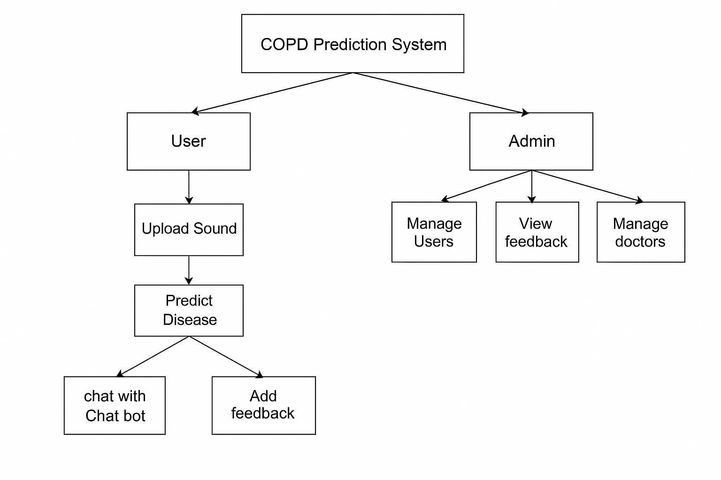
PROPOSED SYSTEM ARCHITECTURE

Slide 11
ARCHITECTURE EXPLANATION
USER Interface (UI) - Users can interact with the COPD Prediction System. Designed using HTML, CSS, Bootstrap . Users must register and log in to access system features.
Lung Sound Input Module - Users upload lung sound recordings for analysis. The sound file should be in WAV / MP3 format
Machine Learning Processing Unit - Sound data is processed using CNN and LSTM models.
Prediction Engine - The trained ML models predict COPD risk based on lung sound patterns. Provides a real-time result
Chatbot Assistance Module - chatbot gives instant information about COPD and Allows users to ask questions about the predicted condition.

Slide 12
Doctor Recommendation Module - Users can search for doctors based on location filters. Displays a list of registered pulmonologists for consultations.
Appointment Scheduling System - After selecting a doctor, users can schedule appointments. Displays available time slots and confirmation details.
Database Management System - Backend powered by SQLite3, storing user records, lung sound files, and doctor details. Maintains login credentials, prediction history, and appointments.
ADMIN :
Admin Panel - Allows administrators to monitor user activity.
Manages doctor registrations, feedback, and system improvement
Feedback System - Users can submit feedback about their experience. Helps in improving the chatbot and prediction accuracy.

Slide 13
Can log in Can see all registered users Can add or update doctor details Can read feedback from users.
SYSTEM MODULES
ADMIN
USER
Registration & login
Upload sound file
Can filter and find doctors
Ask questions to the chatbot to learn more about COPD.
Can send feedback about their experience to the admin.

Slide 14
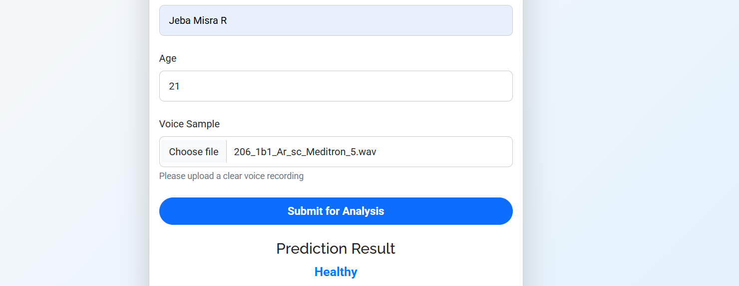
Result Of Prediction In Analysis

Slide 15
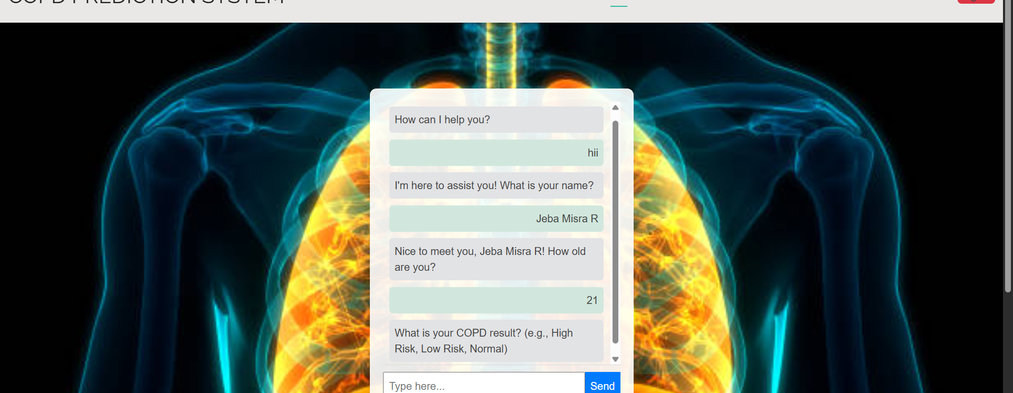
Chatbot Assistence

Slide 16
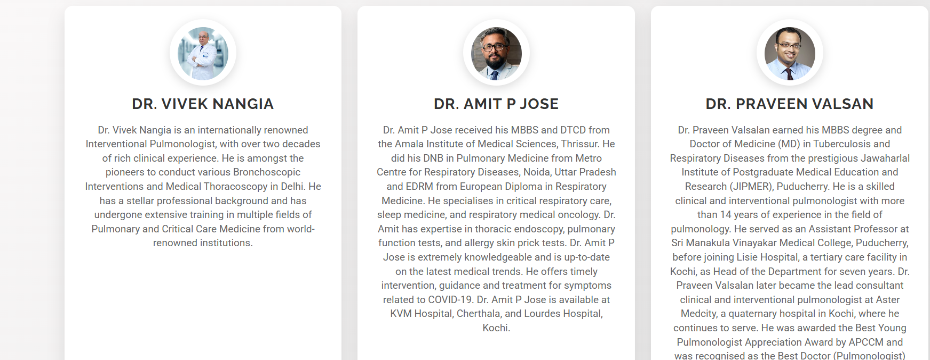
Doctor Lists

Slide 17
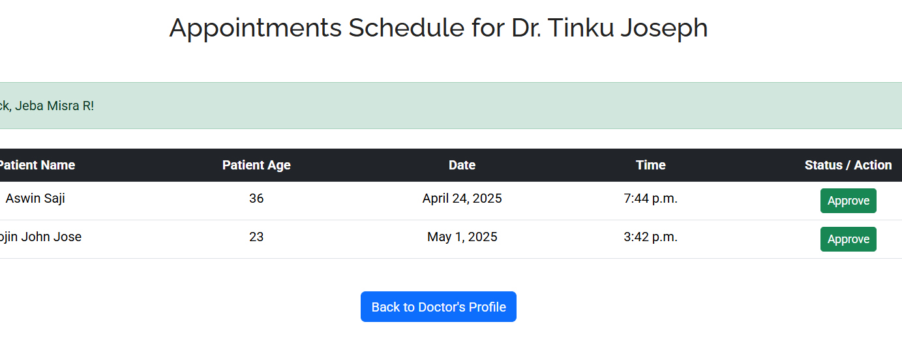
Appointment For Doctor

Slide 18
FEATURE | EXISTING SYSTEM | PROPOSED SYSTEM
Diagnosis Method | Manual (spirometry, CT scans) | Automated lung sound analysis
Availability | Often visit to hospitals | Accessible via web/mobile interface
Cost Efficiency | High (imaging tests, doctor fees) | Low (AI-driven self assessment)
Predictive Insights | No early detection | AI-based early COPD prediction
Doctor Connectivity | Requires hospital visits | Online doctor consultation

Slide 19
CONCLUSION
The COPD Prediction System provides an AI-powered solution for early detection and healthcare support.
By using ML models, the system accurately analyzes lung sounds to predict COPD risk.
The integrated chatbot assistance enhances user engagement, offering personalized health guidance and disease-related information.
With doctor appointment scheduling, users can access medical support,
This system enhances accessibility, efficiency, and accuracy, making healthcare more proactive and effective for COPD patients.

Slide 20
FUTURE ENHANCEMENTS
Integration with Wearable Devices – Smartwatches and respiratory sensors will continuously track lung health.
Multi-Disease Detection System – The system will extend predictions to asthma, pneumonia, and lung infections.
Mobile App & Telemedicine Expansion – A mobile app will provide easier access and allow AI-assisted doctor consultations.
Multilingual AI Chatbot & Voice Assistance – Voice-based interactions and multiple language support will improve accessibility
Electronic Health Records (EHRs) – Doctors can see patient history and reports in one place, making treatment easier and more effective.

Slide 21
REFERENCES
• Huang, Z., Yu, Y., Gu, J., Liu, H. (2024). An Efficient Method for Traffic Sign Recognition Based on Extreme Learning Machine. Neurocomputing, Elsevier.
• Orangi-Fard, N. (2024). Prediction of COPD Using Machine Learning, Clinical Summary Notes, and Vital Signs. arXiv.
• Chen, Z., Hao, J., Sun, H. (2025). Applications of Digital Health Technologies and AI in COPD. BMC Medical Informatics.
• Shen, X., Liu, H. (2024). Using Machine Learning for Early Detection of COPD. Respiratory Research.
• Kurniawan, R., Susilo, B. (2025). Revolutionizing COPD and Asthma Management with AI. Mendeley Data.

